Slide 1
Are We Ready for Metaverse? A Measurement Study of Social Virtual Reality Platforms
ACM IMC 2022
Ruizhi Cheng, Nan Wu, Matteo Varvello*, Songqing Chen, and Bo Han
George Mason University *Nokia Bell Labs

Slide 2




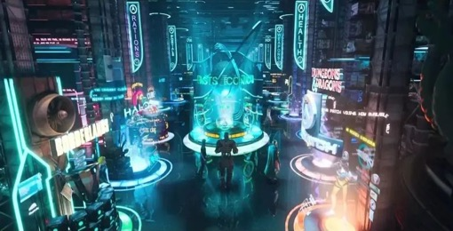

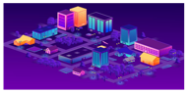


Metaverse
Real-world
Currency
Real-world
Objects
What is Metaverse?
A collection of 3D virtual worlds connected via Internet^{[1]}
Physical
World
XR
AI
Non-fungible Token
Blockchain
Digital
Twins
Metaverse
How far are we from the envisioned Metaverse?
Trade
Decorate
Social Events
User-generated Content
5G, XR
[1] Ruizhi Cheng, Nan Wu, Songqing Chen, and Bo Han. Will Metaverse be NextG Internet? Vision, Hype, and Reality. IEEE Network, 2022.
XR Devices
3D Modeling
Elements of Metaverse and their interaction with physical world

Slide 3
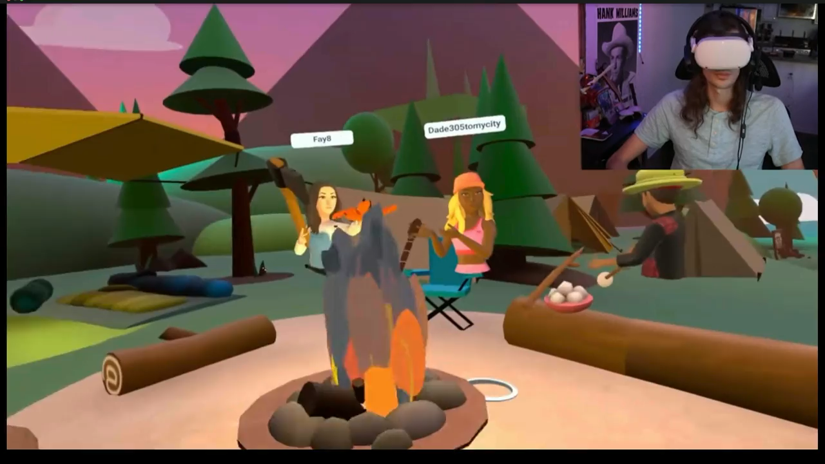
Social VR
Background
Social Media + VR System
A prototype of Metaverse^{[2]}
Motivation
Lack of attention in network community
Understand current development stage of Metaverse
https://www.youtube.com/watch?v=udi5a6ynYuw
[2] What is Metaverse? A Futuristic Ride to Virtual Worlds https://www.emizentech.com/blog/metaverse.html

Slide 4
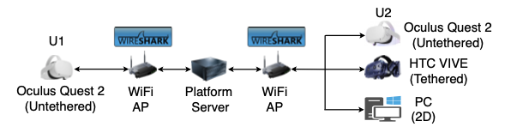
Measurement Setup
Platforms
Horizon Worlds (Meta), AltspaceVR (Microsoft), Mozilla Hubs (Mozilla), Rec Room, and VRChat
Mozilla Hubs: Public Server + Private Server on AWS
Testbed & Data Collection
Most experiments: two Quest 2
Wireshark on AP for network traffic
OVR Metrics Tool for performance and resource utilization
Data collected from 2/2022 to 5/2022
Measurement setup with two users U1 and U2

Slide 5
Key Observations
All platforms employ different protocols for control and data channels
Throughput of all platforms is low (<1Mbps)
Throughput not depend on resolution and mainly contributed by avatar
All platforms have throughput, on-device resource utilization, FPS, and end-to-end latency scalability issues

Slide 6
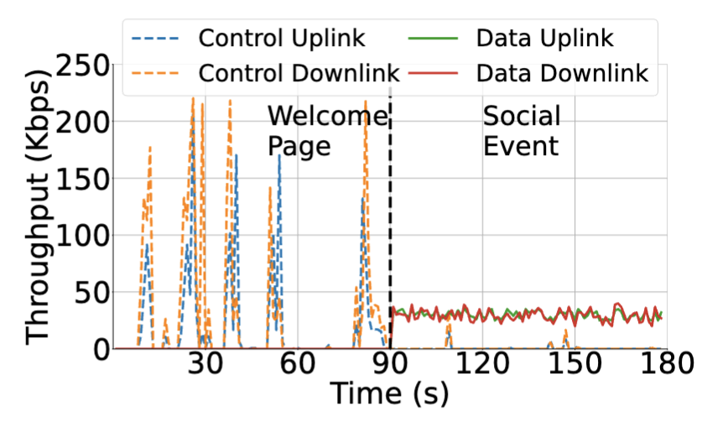
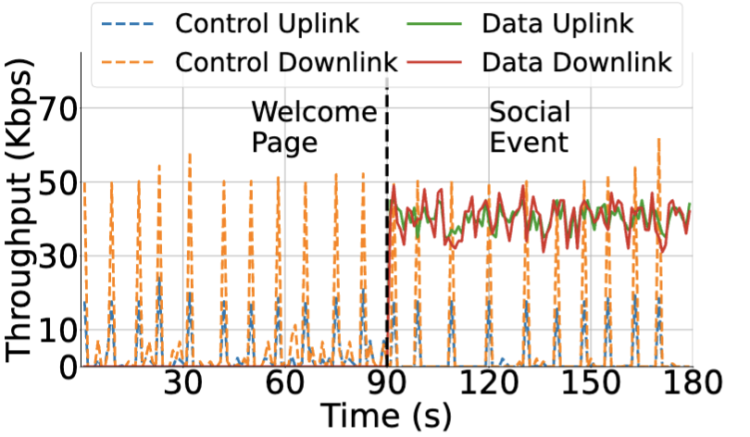
Network Protocols
Two channels: data and control
Used under different scenarios
Different owners/geolocations/hostnames
VRChat
AltspaceVR

Slide 7
Network Protocols
Control channel
Users interact with the platform (e.g., menu operations)
All platforms use HTTPS
Data channel
Users interact with each other (e.g., avatar motion and voice data)
Mozilla Hubs: WebRTC (RTP/RTCP) for voice and HTTPS for avatar
Others: UDP
Platforms | Control Channel | Data Channel
AltspaceVR | HTTPS | UDP
Mozilla Hubs | HTTPS | RTP/RTCP HTTPS
Rec Room | HTTPS | UDP
VRChat | HTTPS | UDP
Horizon Worlds | HTTPS | UDP

Slide 8
Network Infrastructure
Control channel
Mozilla Hubs: >70ms RTT
Others: nearby or anycast servers with <5ms RTT
Data channel
Mozilla Hubs: new RTP/RTCP server for WebRTC. Others: new UDP server
Mozilla Hubs and AltsapceVR: >70ms RTT
Others: <5ms RTT
Platforms | Control Channel | Data Channel
AltspaceVR | 3.08 | 72.1
Mozilla Hubs | 74.1 | 73.5
Rec Room | 2.21 | 2.97
VRChat | 2.32 | 3.24
Horizon Worlds | 2.23 | 2.71
Experiments were conducted in eastern U.S.

Slide 9
Throughput Analysis
Control channel
Bursty data transmission
5–20 KB for uplink and 15–600 KB for downlink
Data channel
<1Mbps for all platforms
Not depend on resolution of displayed content
Horizon Worlds has the highest throughput
Evidence of local rendering
Platforms | Tput (Kbps) |  | Resolution
 | Up | Down
VRChat | 31.4 | 31.1 | 1440X1584
AltspaceVR | 41.3 | 40.4 | 2016X2224
Rec Room | 41.7 | 41.5 | 1224X1346
Mozilla Hubs | 83.3 | 83.1 | 1216X1344
Horizon Worlds | 752 | 413 | 1440X1584
Two users with Quest 2

Slide 10




Throughput Analysis
What is being delivered?
Virtual background: static
Avatar embodiment and motion: a large portion
Why Horizon Worlds > others?
More realistic avatars
→ More transmitted 3D coordinates
Why throughput of all platforms is low?
Lack of high-quality full-body tracking avatars
Platforms | Tput (Kbps) |  | Avatar (Kbps)
 | Up | Down
VRChat | 31.4 | 31.1 | 24.7
Rec Room | 41.7 | 41.5 | 35.2
Mozilla Hubs | 83.3 | 83.1 | 77.4
AltspaceVR | 41.3 | 40.4 | 11.1
Horizon Worlds | 752 | 413 | 332
Required in fully-fledged Metaverse
Worlds
Worlds
AltspaceVR

Slide 11
Scalability Analysis
Controlled Experiments
U2, U3, U4, and U5 join at 50, 100, 150, and 200s, respectively
Throughput of all platforms increases almost linearly
Server forwards data among users
Evidence of local rendering
U1, U2, U3
U1
U1, U2, U3, U4, U5
Horizon Worlds

Slide 12
Viewport-adaptive Optimization
Update for only avatars contained within a user’s viewport
U1: <250s: face other avatars, >250s: turn around for 180°
Only AltspaceVR benefits from viewport-adaptive optimization
U1, U2, U3, U4, U5
U1 turn around
U1, U2, U3, U4, U5
U1 face others
Save up to ∼58% of data consumption
AltspaceVR

Slide 13

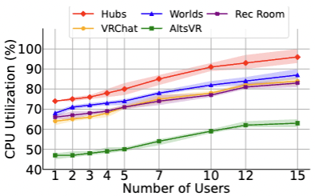
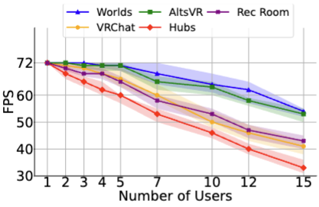
Scalability Analysis
Measurement in the Wild
Throughput increases almost linearly
CPU and GPU utilization increases
Mozilla Hubs: web-based → CPU utilization
FPS drops
All platforms <60 (15 users)
Mozilla Hubs: highest CPU utilization → lowest FPS
60 FPS is the minimum requirement of VR^{[3]}
[3] Zeqi Lai et al. Furion: Engineering High-Quality Immersive Virtual Reality on Today’s Mobile Devices. ACM MobiCom, 2017.

Slide 14

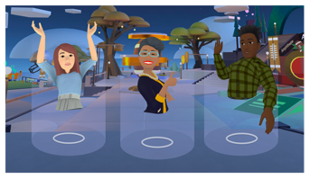
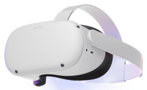
Addressing Scalability Issues
Root cause: local rendering
Server forwards data → throughput linearly increases as # users
# users→ rendering overhead
Headset's fair CPU/GPU → low FPS
Potential solution: remote rendering
Amount of data independent of # users
Server's powerful CPU/GPU → high FPS
Render
Powerful CPU/GPU
Upload
Upload
Forward
A video frame
Render
Fair CPU/GPU

Slide 15
End-to-end Latency
End-to-end (E2E) latency: T'_{U2} – T_{U1}
Sync Quest 2 and WiFi AP
Breakdown E2E latency based on packet delivery time on WiFi AP
U1's viewport: T'_{U1}
U1's viewport: T_{U1}
U2's viewport: T'_{U2}
U2's viewport: T_{U2}

Slide 16
End-to-end Latency
150ms is threshold^{[4]}
Mozilla Hubs on official server
RTT >70ms
CPU utilization → sender/receiver processing delay
Server not handling forwarding workload well
AltspaceVR
RTT >70ms
Viewport-adaptive optimization → server processing latency
Platforms | E2E | Sender | Receiver | Server
Rec Room | 101.7 | 25.9 | 39.9 | 29.9
VRChat | 104.3 | 27.3 | 37.4 | 33.5
Horizon Worlds | 128.5 | 26.2 | 49.1 | 40.2
AltspaceVR | 209.2 | 24.5 | 36.1 | 68.6
Mozilla Hubs | 239.1 | 42.4 | 60.1 | 52.2
Mozilla Hubs* | 130.7 | 40.3 | 61.5 | 16.2
Two users
Mozilla Hubs*: our private server
Experiments were conducted in the eastern U.S.
[4] David Roberts et al. Comparing the End-to-End Latency of an Immersive Collaborative Environment and a Video Conference. IEEE/ACM International Symposium on Distributed Simulation and Real Time Applications, 2009.

Slide 17
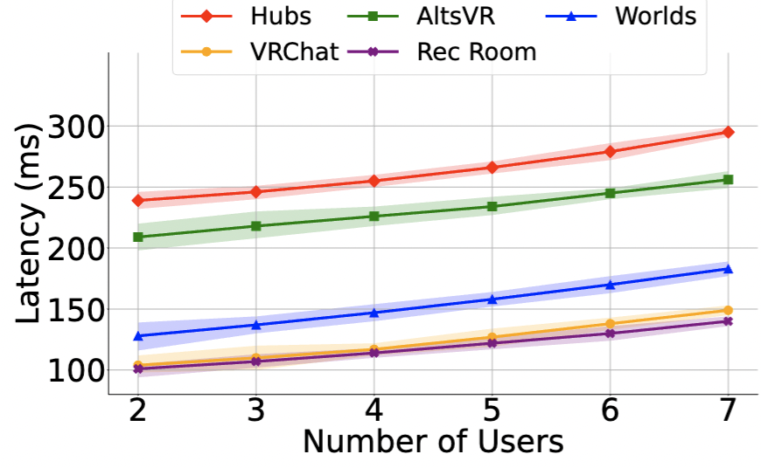
End-to-end Latency
150ms is threshold^{[4]}
Scalability Issue
All platforms higher or near 150ms (7 users)
[4] David Roberts et al. Comparing the End-to-End Latency of an Immersive Collaborative Environment and a Video Conference. IEEE/ACM International Symposium on Distributed Simulation and Real Time Applications, 2009.

Slide 18
Other Experiments
A large-scale (N=37) experiment on Mozilla Hubs
Bandwidth, latency, and packet loss disruptions
Understanding user experience on five platforms

Slide 19
Conclusion
All five platforms are in early stage to realize the grand vision of Metaverse
Local rendering leads to throughput, FPS, and resource utilization scalability issues
Avatar embodiments fail to provide a truly immersive experience
End-to-end latency is high
Future Work
Decrypt traffic using existing tools
Measure other types of Metaverse platforms
Build an open-source tool to facilitate large-scale measurement in the wild
The source code is available at https://github.com/felixshing/Metaverse_IMC2022

